Slide 1
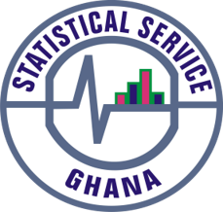
PRESS RELEASE
GHANA, October 2022
CONSUMER PRICE INDEX AND INFLATION
9th November 2022

Slide 2
In this release, we present:
Definition and Measurement of Consumer Price Index (CPI) and Rate of Inflation
CPI and Rate of Inflation for October 2022
Dominant Divisions of Rate of Inflation for October 2022
Disaggregation of Rate of Inflation for October 2022
Highlights of CPI and Rate of Inflation for October 2022

Slide 3
Definition and measurement of CPI and rate of inflation (1/3)
CPI measures changes in the price of a fixed basket of goods and services purchased by households
The assumption is that the basket is purchased each month, hence as price changes each month, the total price of the basket will also change
The rate of inflation is the relative change in CPI between periods
Inflation is reported year-on-year (annual inflation) and month-on-month (monthly inflation), and granulated to determine regional and commodity type and source of inflation
2
2

Slide 4
Definition and measurement of CPI and rate of inflation (2/3)
CPI does not measure price levels
The measures of CPI and inflation are based on the Consumer Price Index Manual: Concepts and Methods
Data (market readings) are captured monthly
Key variables are prices, quantities and expenditure weights of items
Price reference year for the New Series is 2021 (2021 = 100)
3

Slide 5
Definition and measurement of CPI and rate of inflation (3/3)
Prices are collected for 47,877 products every month from 16 regions.
Price collection is done in 57 markets
Prices are collected from about 8,337 outlets.
Products are ordered in a hierarchy of 13 Divisions, 44 Groups, 98 Classes, 156 Subclasses and 307 Items.
Every Item can only be part of one Subclass, and every Subclass can only be part of one Class, etc.
4

Slide 6
Consumer Price Index and Rate of Inflation for Oct. 2022
CPI for October 2022 based on the new series was 144.4 relative to 102.9 for October 2021 using the linked series
Year-on-year inflation rate for October 2022 was 40.4%
This means that in the month of October 2022 the general price level was 40.4% higher than October 2021
Month-on-month inflation between September and October 2022 was 2.7%
Month | CPI | Inflation
 |  | Monthly | Yearly
Oct 2021 | 102.9
Sept-2022 | 140.6 | 2.0% | 37.2%
Oct-2022 | 144.4 | 2.7% | 40.4%
5
Notes:
Year-on-Year inflation for October 2022 (40.4%) is 3.2 percentage points higher than the rate recorded in September 2022 (37.2%)
Month-on-month inflation for October 2022 (2.7%) is 0.7 percentage points higher than the rate recorded in September 2022 (2.0%)

Slide 7
Disaggregation of October 2022 Rate of Inflation
Food inflation (0.437) was 43.7%
  Last month’s Food inflation was 37.8%
  Month-on-month Food inflation was 3.2%.
Non-food Inflation (0.563) was 37.8%
  Last month’s Non-Food inflation was 36.8%
  Month-on-month Non-Food inflation was 2.3%
Inflation for locally produced items was 39.1%
Inflation for imported items was 43.7%
6
Notes:
On year-on-year basis, the difference between Food inflation (43.7%) and Non-food (37.8%) was 5.9 percentage points.
On month-on-month basis, food inflation (3.2%) records a lower rate than non-food (2.3%), leading to 0.9 percentage point difference.
The percentage point difference between inflation for imported items (43.7%) and locally domestic items (39.1%) was 4.6

Slide 8
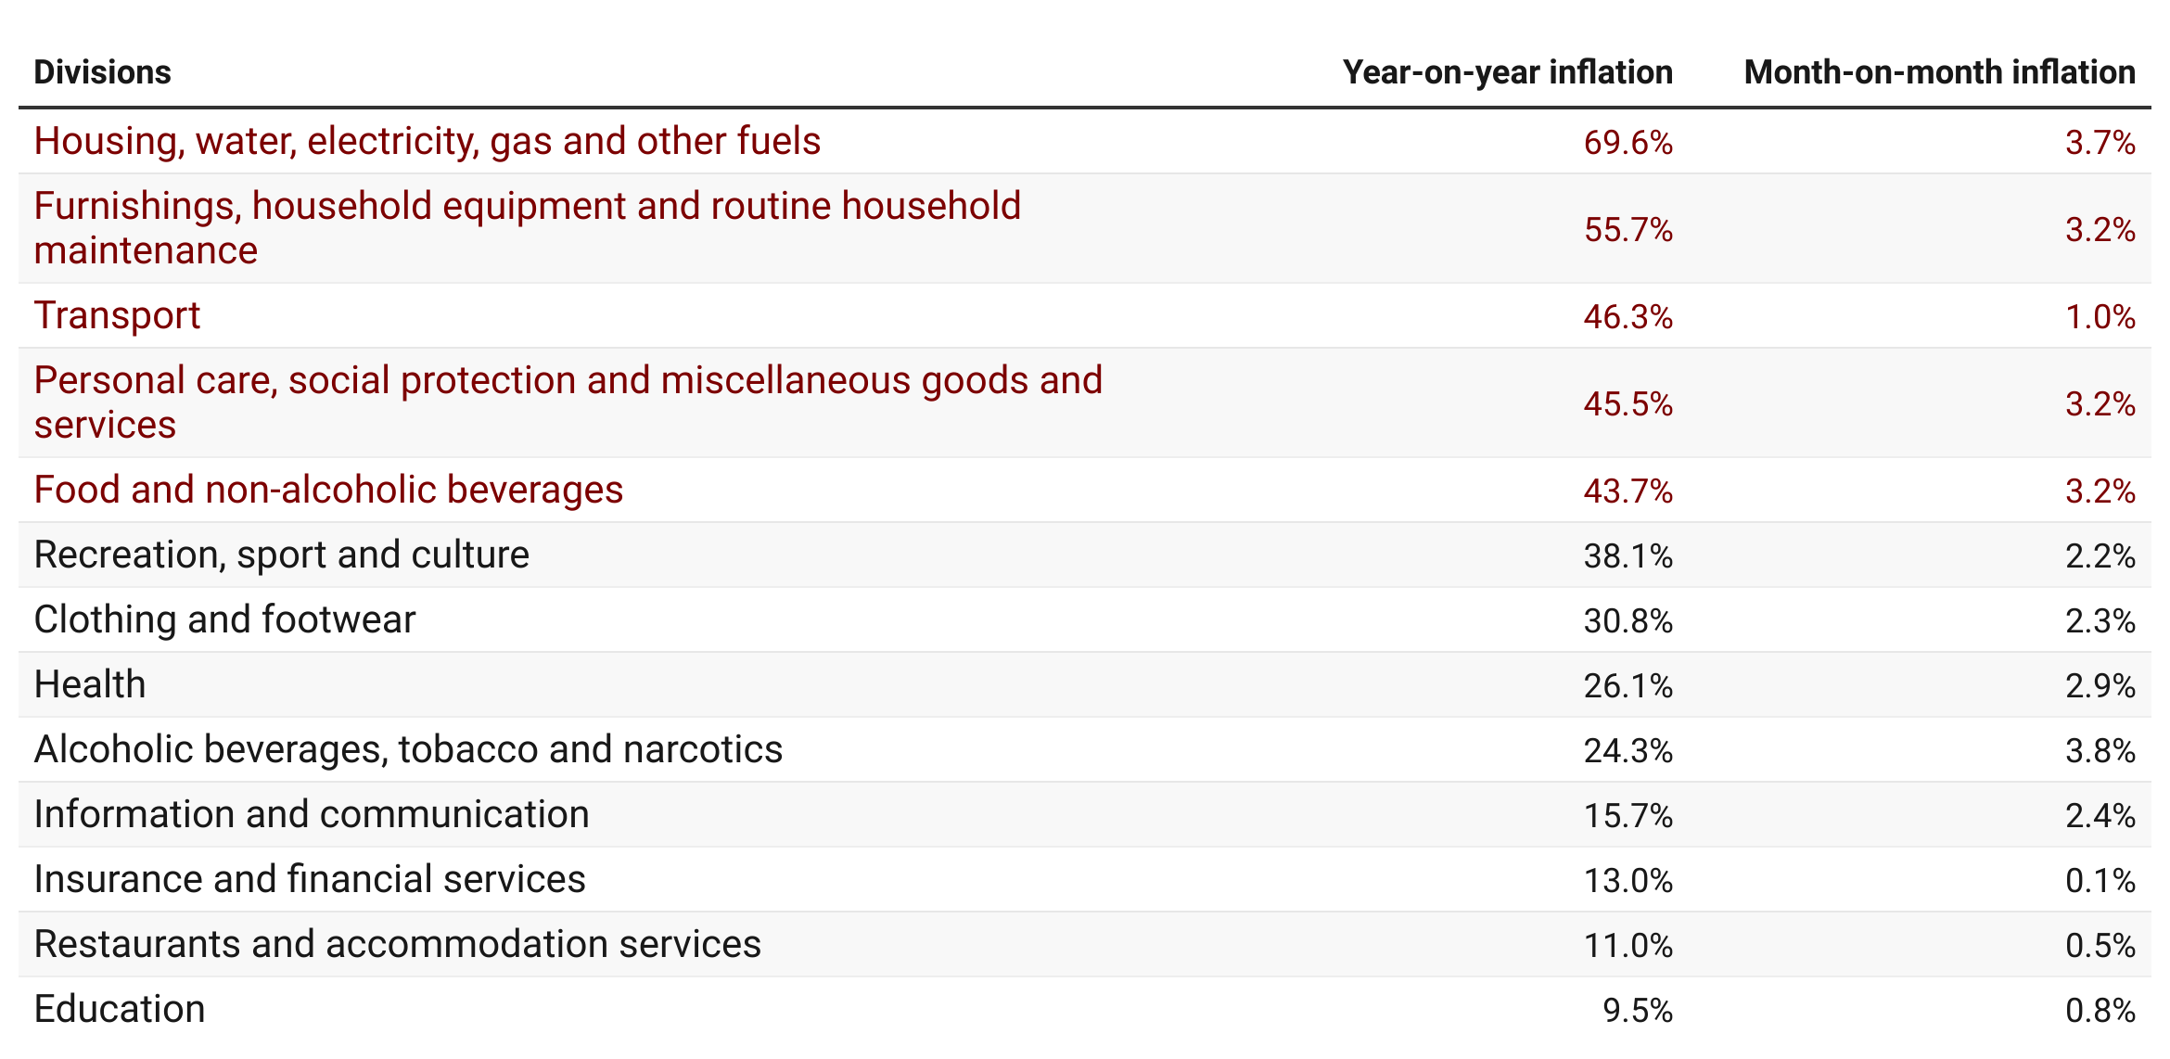
Disaggregation of year-on-year inflation by Division (1/2)
7
Notes:
Five divisions record inflation rates higher than the national average (40.4%).
Wide disparity is observed across the 13 divisions with Y-o-Y Housing, water electricity, gas and other fuels leading by 69.6%, followed by Furnishings, household equipment and routine household maintenance (55.7%), Transport 46.3% and Personal care, social protection and miscellaneous goods and services (45.5% and Food and Non-Alcoholic Beverages (43.7%). The division with the highest Y-o-Y inflation (Housing, water electricity, gas and other fuels) is more than seven times as high as the lowest (Education Service (9.5%)).
On a month-on-month basis, Alcoholic beverages, tobacco and narcotics records the highest inflation (3.8%) and the Insurance and Financial Services record the lowest, 0.1%Services.

Slide 9
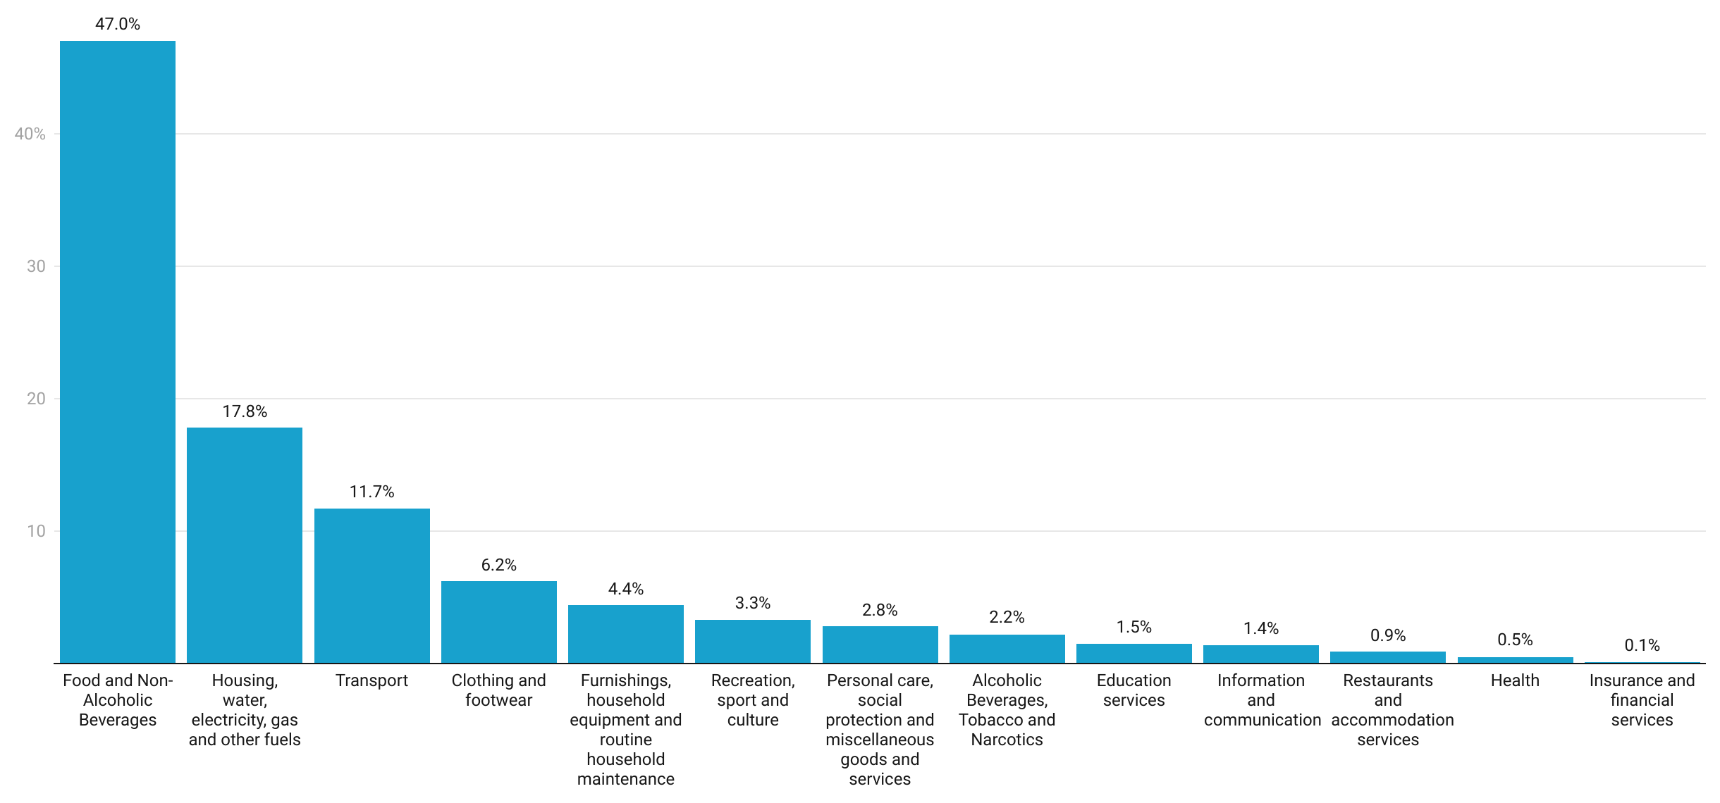
Shares of Inflation Across Divisions
8
Notes:
The share of Food and Non-Alcoholic Beverages is the highest 47.0%, followed distantly by Housing, Water, Electricity and Gas (17.8%), Transport 11.7% and the division with the least share is Insurance and Financial Services, 0.1%.
The top three divisions {Food and Non-Alcoholic Beverages (47.0%); Housing, Water, Electricity, Gas and Other Fuels (17.8%); and Transport (11.7)} contributed more than three quarters to the rate of inflation in October 2022.

Slide 10
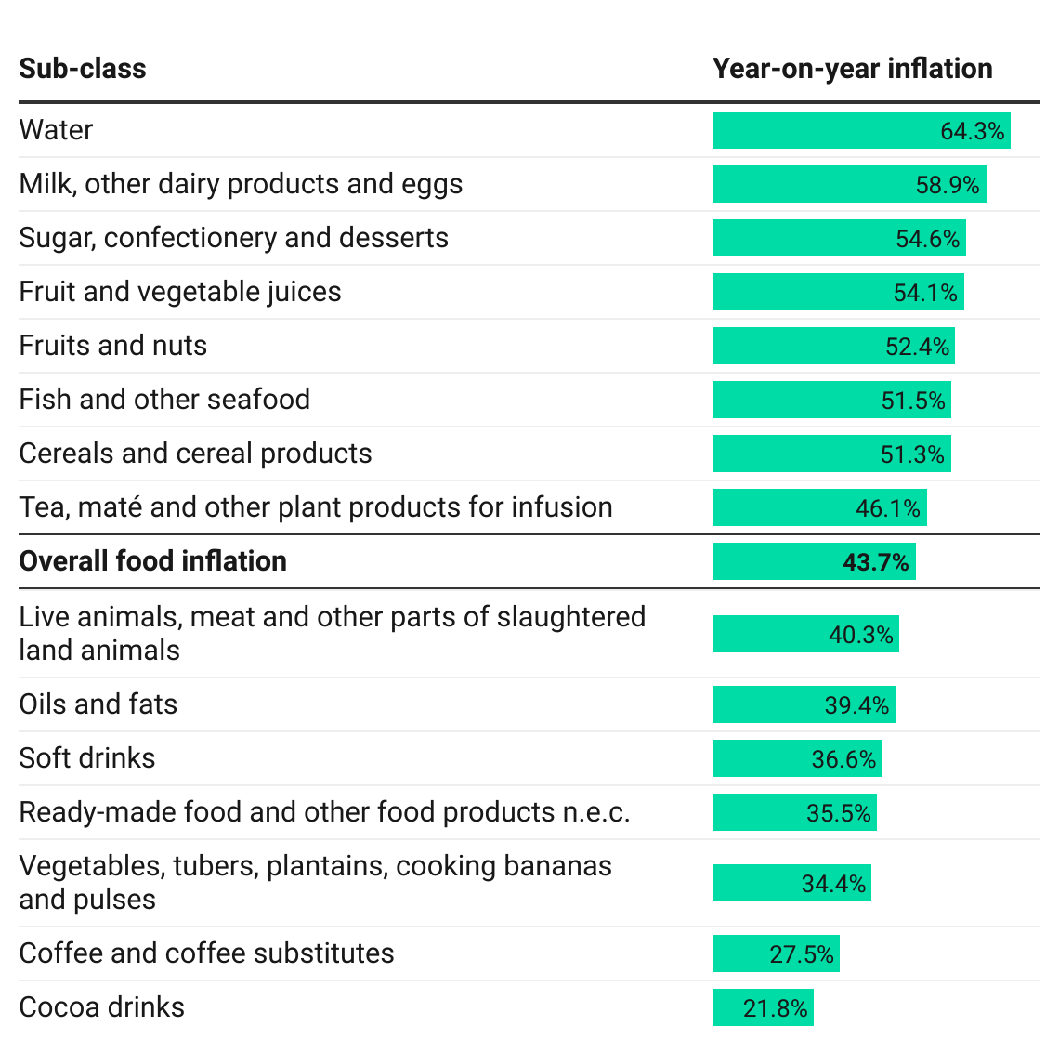
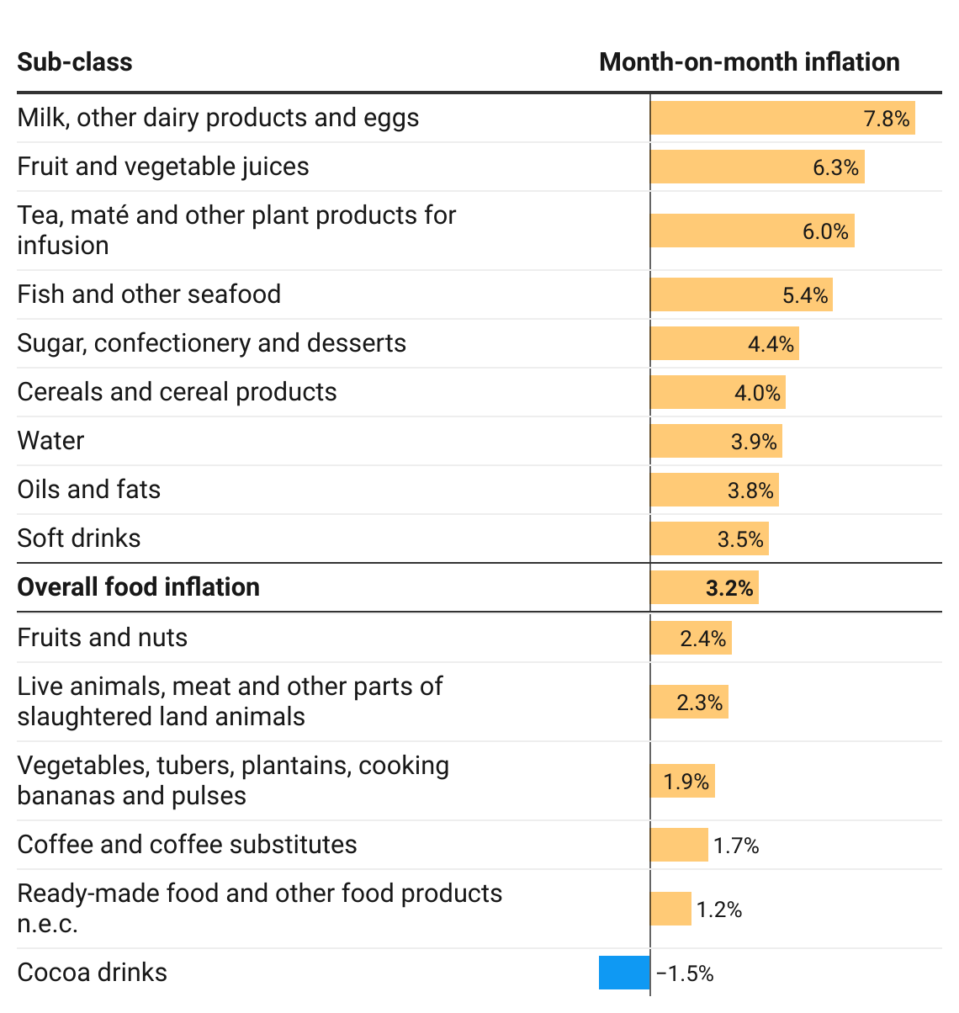
Disaggregation of YoY and MoM Food Inflation by Subclass
9
Notes:
Focusing on food inflation on a year-on-year basis (43.7%) for October 2022, 8 subclasses recorded higher rates. This was distantly led by Water (64.3%) followed by Milk, Other Dairy Products and Eggs (58.9%) and Sugar, Confectionery and desserts (54.6%). Also in the case of month-on-month food inflation (3.2%) 9 subclasses record rates higher than the national average. Milk and Other Dairy Products and Eggs recorded the highest, 7.8%.
On a month-on-month basis cocoa drinks recorded a deflation of 1.5%

Slide 11
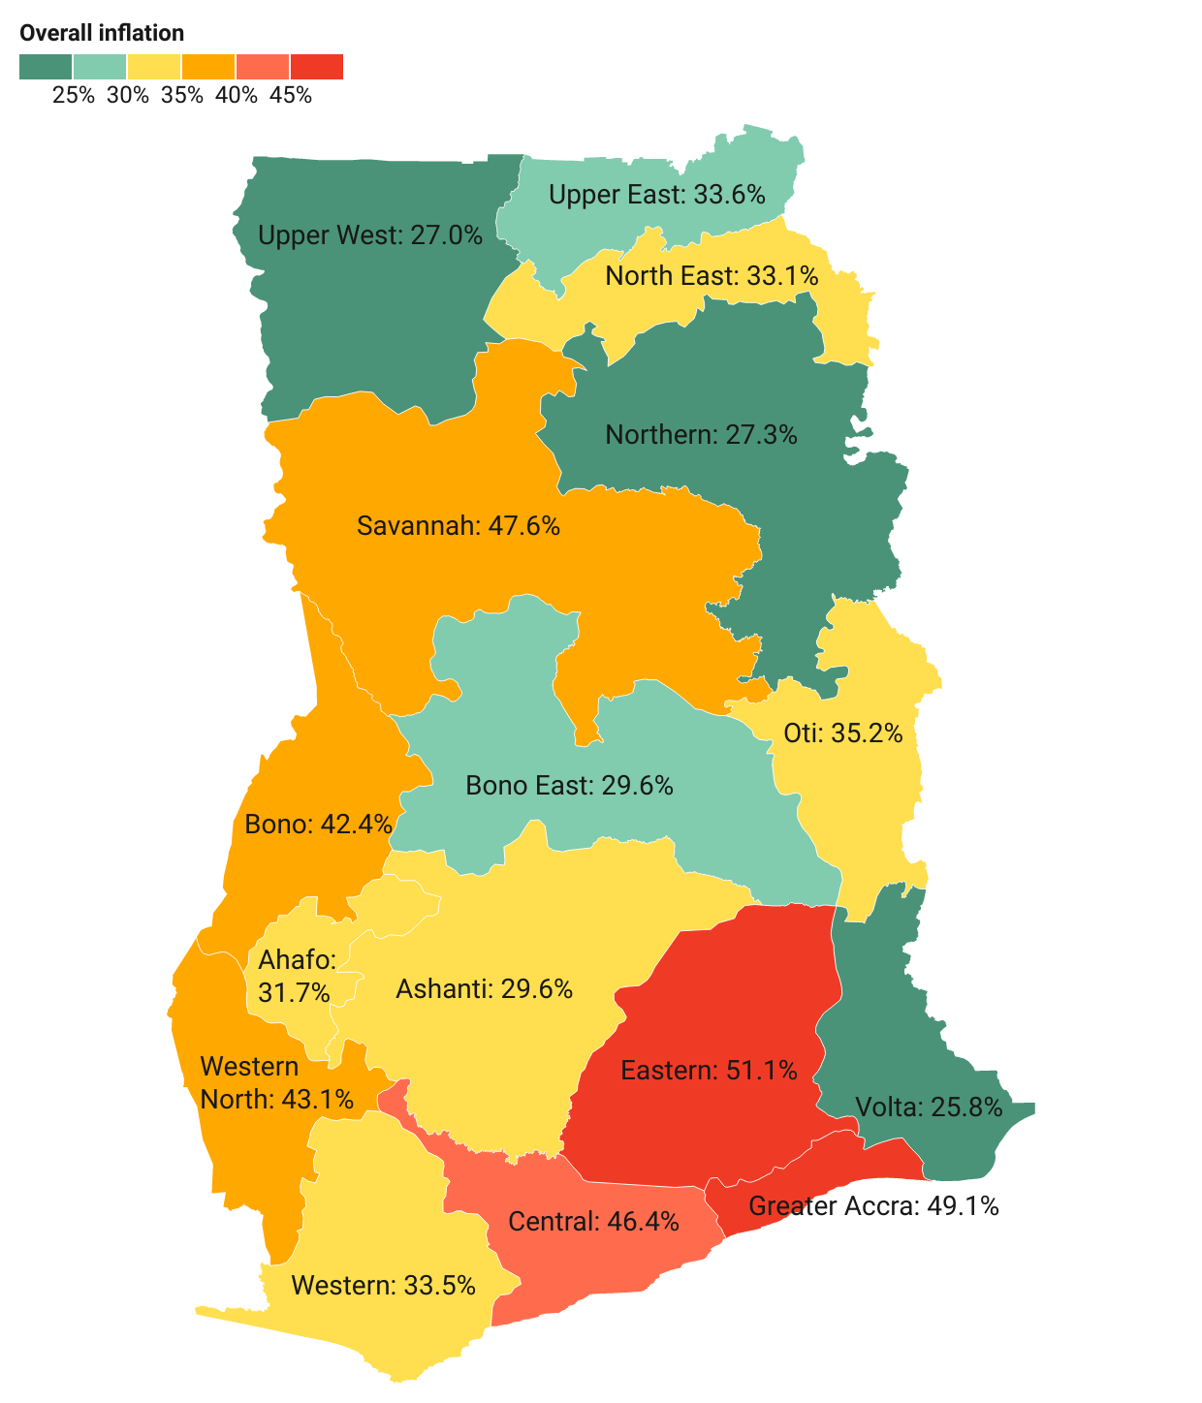
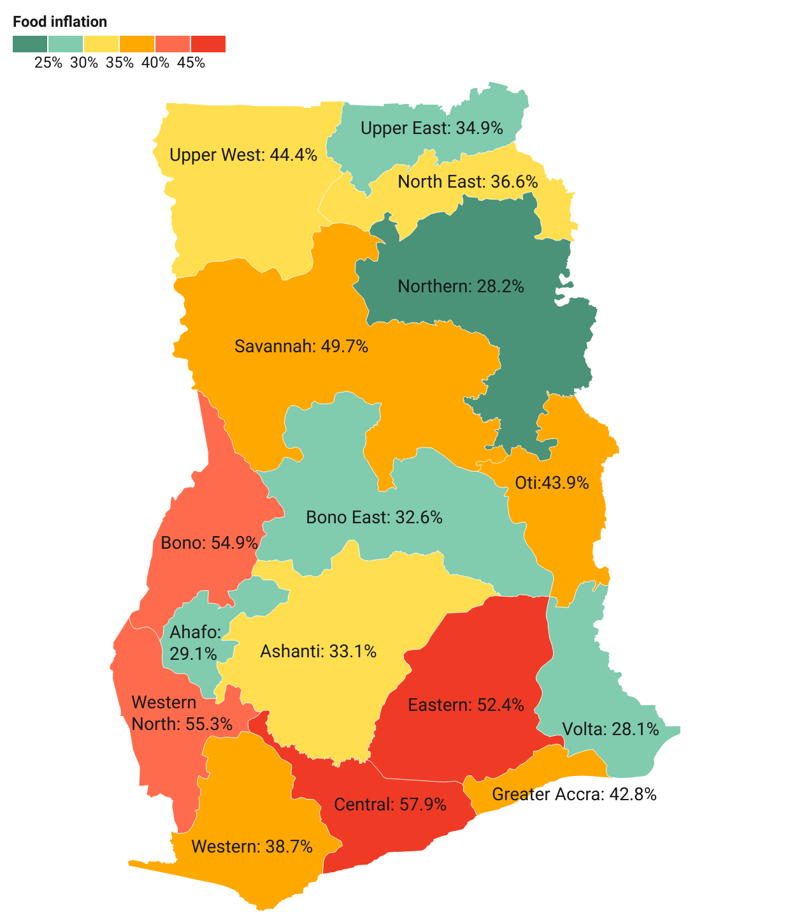
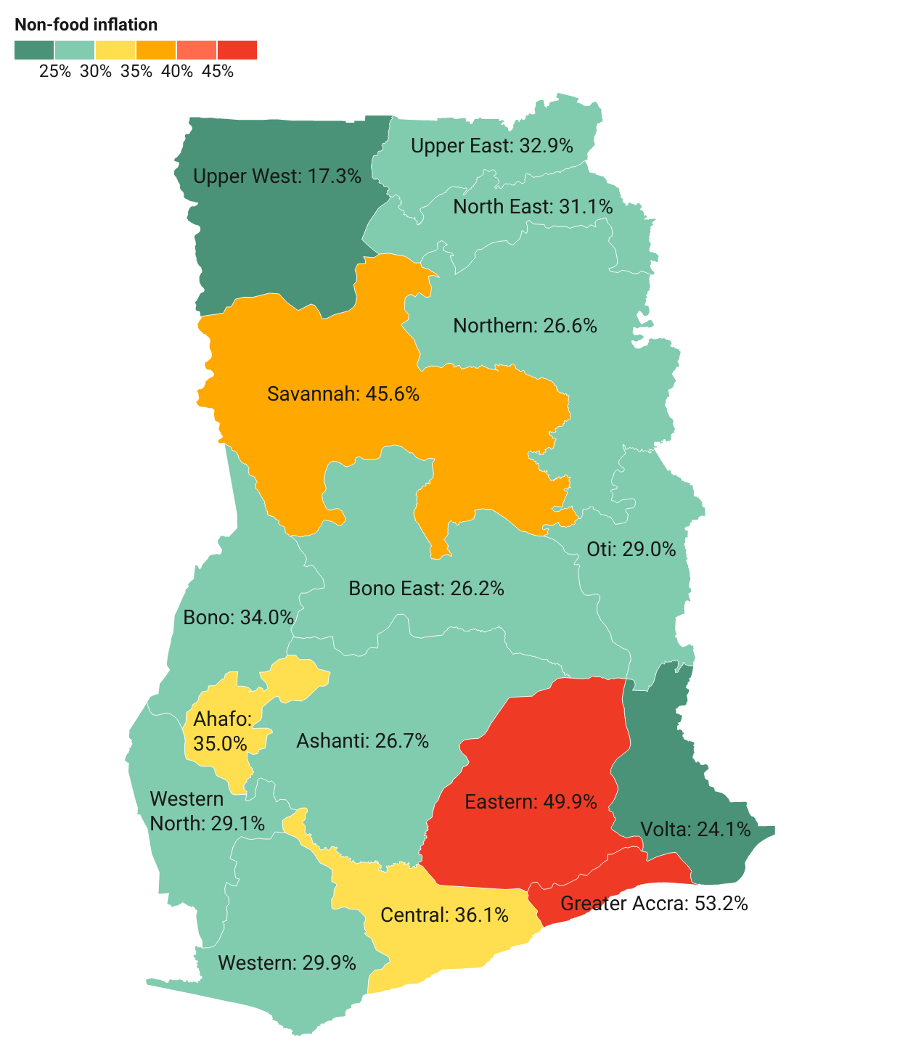
October 2022 Regional Rates of inflation
10
Notes:
Central Region (57.9%) recorded the highest food inflation while Greater Accra recorded the highest non-food inflation (53.2%)
The difference between the regions with the highest {Eastern Region 51.1%)} and the lowest {Volta Region(25.8)} rates of inflation for October 2022 is almost twice
Eastern Region had the overall highest inflation of 51.1%

Slide 12
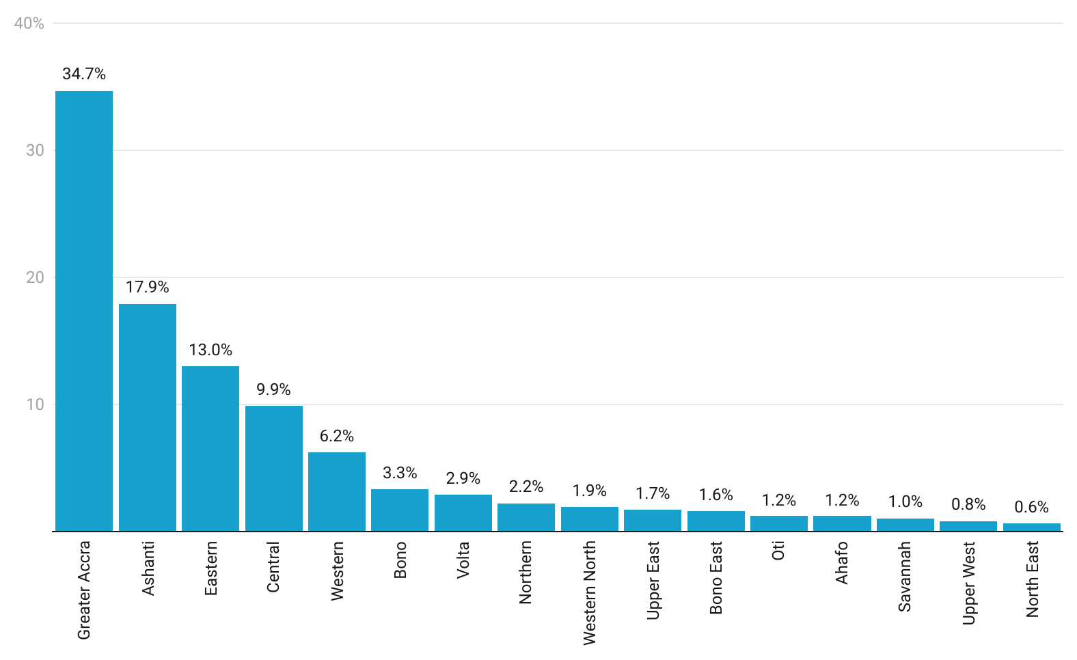
Regional Shares of Inflation
11
Notes:
Greater Accra Region (34.7%) contributed more than one-third of the October 2022, rate of inflation, followed by Ashanti 17.9%. The North East Region contributed the least with 0.6%.

Slide 13
Disaggregation of inflation in Eastern and Central Regions for October 2022
12
Notes:
Housing, water electricity, gas and other fuels (76.2%) recorded the highest rate of inflation in the Eastern Region, for food inflation in the Central Region, Fish and Other Seafood had the highest rate of inflation of 74.5%.

Slide 14
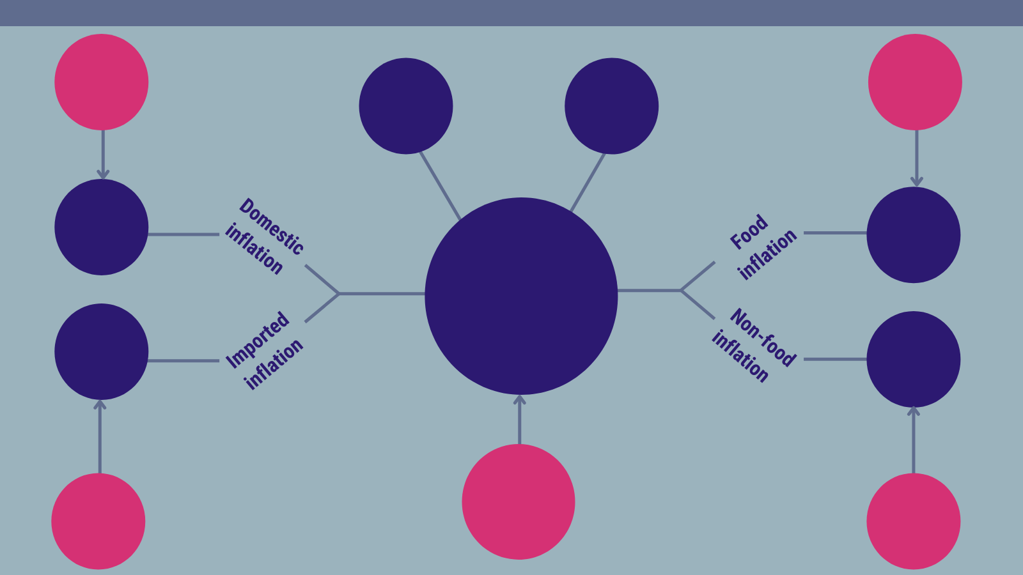
Highlights
35.8%
Domestic inflation Sept 2022
37.8%
Food inflation
Sept 2022
51.1%
Highest regional inflation rate
(Eastern)
25.8%
Lowest regional inflation rate
(Volta)
39.1%
43.7%
40.4%
Year-on-year inflation
October 2022
43.7%
37.8%
37.2%
Year-on-year inflation Sept 2022
40.7%
Imported inflation
Sept 2022
36.8%
Non-food inflation
Sept 2022
Notes:
Y-o-Y inflation varied upwardly by 3.2 percentage points between September (37.2%) and October (40.4%) 2022.

Slide 15
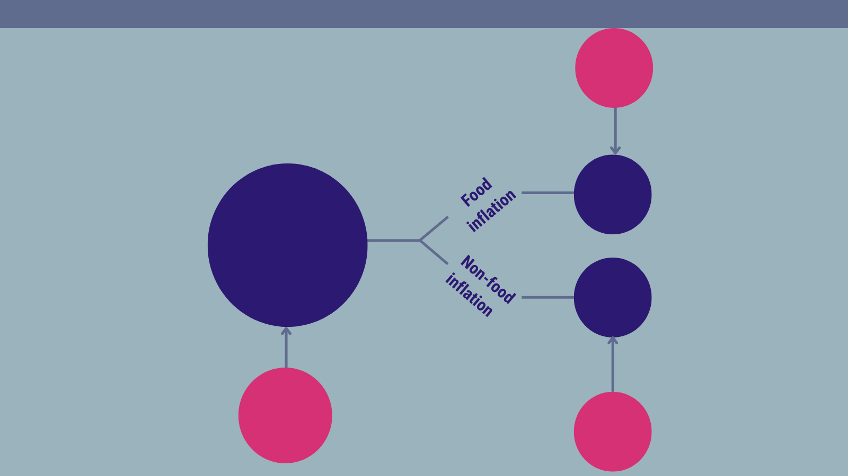
Highlights (2/2)
2.2%
Food inflation
Sept 2022
2.7%
Month-on-month inflation
October 2022
3.2%
2.3%
2.0%
Month-on-month inflation Sept 2022
1.7%
Non-food inflation
Sept 2022

Slide 16
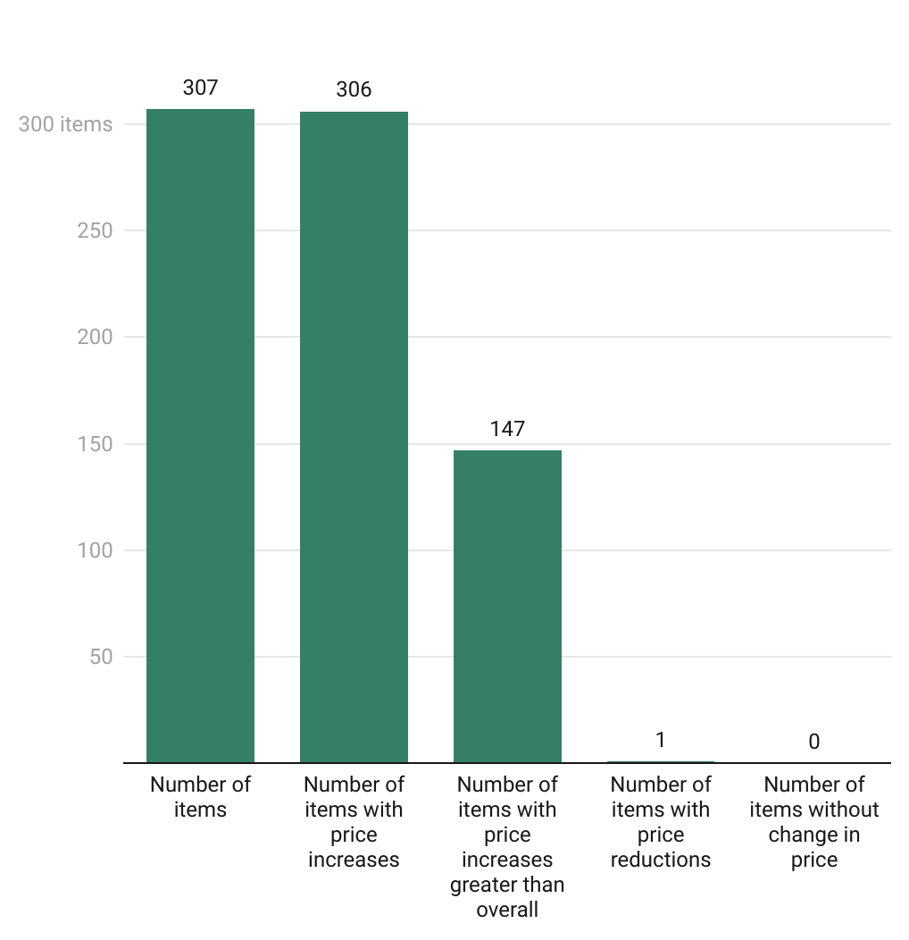
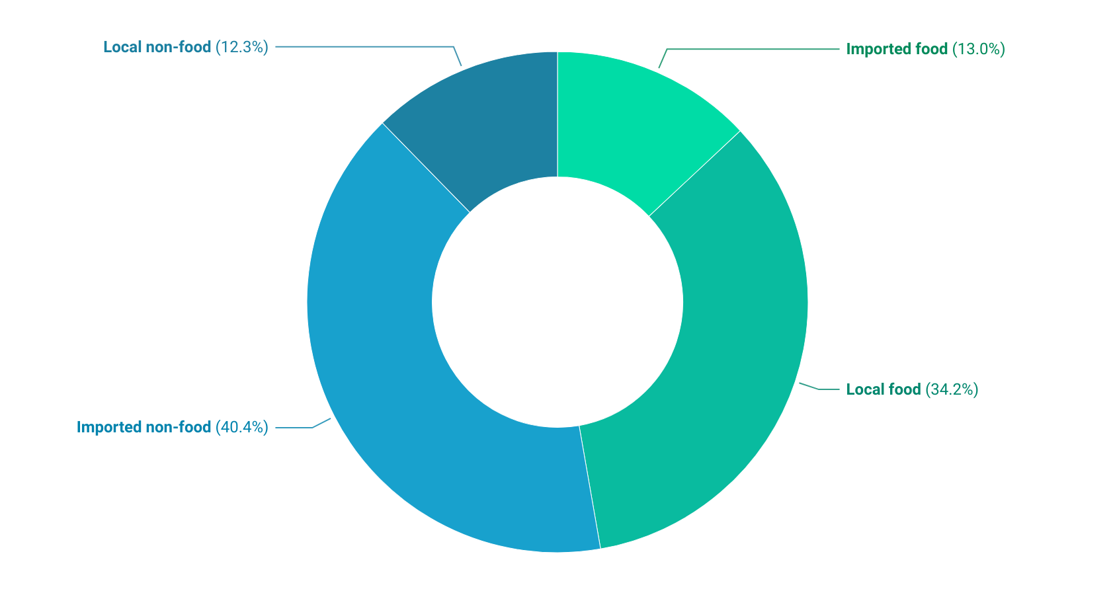
Additional Policy Considerations
15
Notes:
52.7% non-food and 47.2% food.
54.4% imported and 46.5% locally produced

Slide 17
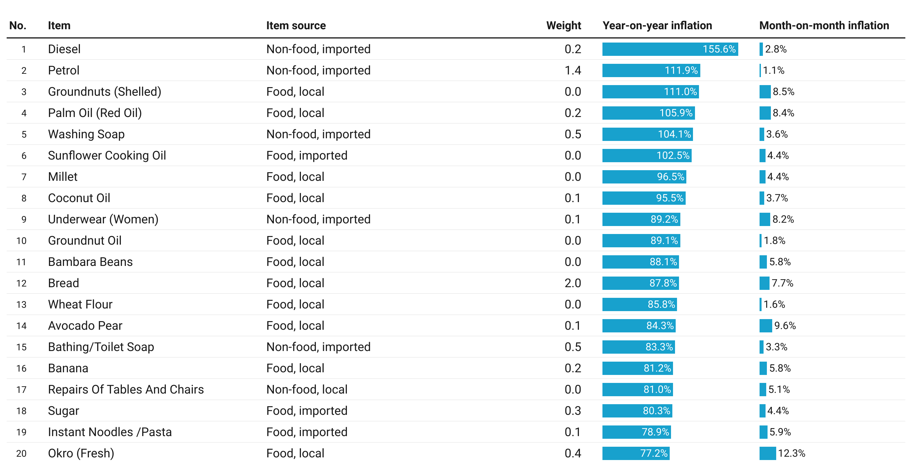
Additional Policy Considerations (1/2)
16

Slide 18
End of Press Release for
October 2022 Consumer Price Index
For enquiries, please contact:
https://statsghana.gov.gh/gssmain/fileUpload/Price%20Indices/CPI_Technical_Guide_v5_Published_14102020.pdf
Mr. John F.K. Agyaho
(Head, Price Statistics, GSS)
john.agyaho@statsghana.gov.gh

Slide 19
Consumer Price Index and Inflation
October 2022

